Slide 1
Monte Carlo Analysis of Shower Carbon Emissions
Muhammad Umar IJAZ

Slide 2

OBJECTIVE:
QUANTIFY CO₂ EMISSIONS FROM HOUSEHOLD SHOWERS
using Monte Carlo simulations (N = 1000)
Understand the true range and distribution of emissions due to:
User behavior (shower length)
Water source
Heat source
Identify low-emission technologies or regions driving sustainability

Slide 3
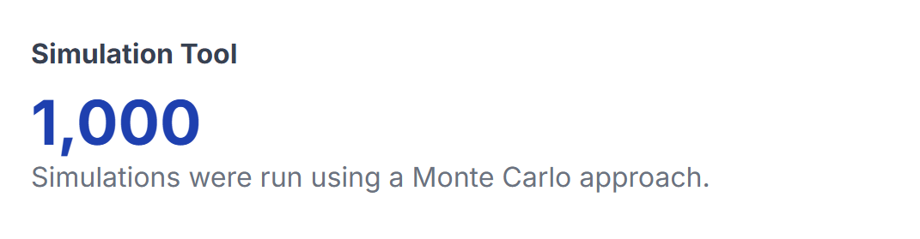
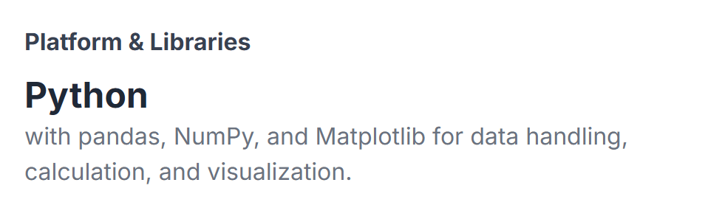
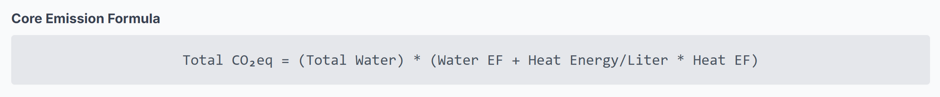
2
2
OUR APPROACH
1
3

Slide 4


Fixed "Constant" Parameters
Flow Rate: 2.5 gallons/minute
Heat Energy: 0.144 MJ/Liter
Key
Stimulation
Parameters
Variable “ Random” Parameters
Shower Length: Log-Normal Distribution
(Mean: 10 min, SD: 3 min)
Heat & Water Source: Multinomial Distribution

Slide 5
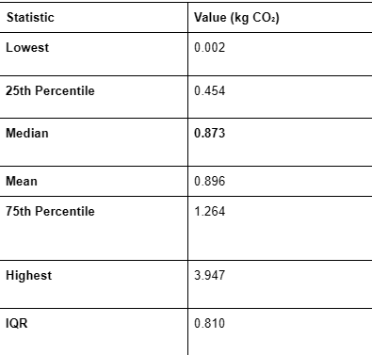

RESULTS : STATISTICAL SUMMARY

Slide 6
Data Visualization
and
Reporting

Slide 7
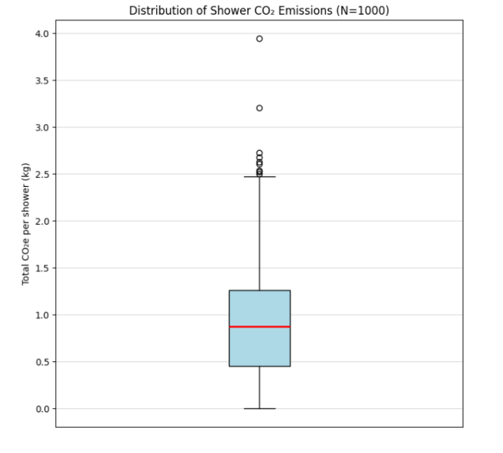
BOXPLOT
Median = 0.87 kg CO₂ ; IQR = 0.81 kg most showers emit 0.45–1.26 kg.
Mean (0.90 kg) > Median :
right-skewed distribution
Few high-emission outliers reach ≈ 3.95 kg CO₂.

Slide 8
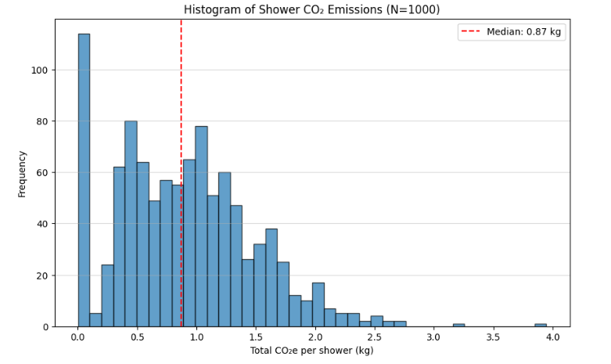
HISTOGRAM
Two visible peaks : bimodal pattern
(typical vs low-emission showers).
Main cluster ≈ 0.9 kg CO₂; small left peak
= clean Swiss heat sources.
Right tail : rare, long-duration or high-carbon showers.

Slide 9

DIAGNOSING LOW-EMISSION MODE
Analyzed bottom 20% of emissions (CO₂ < 0.669 kg)
Heat Source Geography Share:
District/Industrial Heat Switzerland (CH) 47.3%
Low-voltage Electricity Switzerland (CH) 46.8%
Interpretation:
Low emissions strongly linked to clean Swiss heating technologies
Water source has no clear pattern

Slide 10

KEY INSIGHTS:
User behavior (duration) affects variability
Infrastructure (energy source) defines emission category
Two types of showers:
Conventional → 0.9 kg CO2
Clean/renewable grid → near-zero CO2

Slide 11
CONCLUSIONS
&
RECOMMENDATIONS:
Average ≈ 0.896 kg CO₂/shower, rightskewed distribution.
Clean energy sources create a distinct low-emission cluster
All values based on final Monte Carlo run (N = 1000, SEED = 42) ensuring reproducibility.
Conclusion:
Prioritize decarbonizing regional grids
Invest in district heating and heat pumps
Promote shorter showers and efficient water systems
Recommendations:

Slide 12

Thank You!

